Slide 1
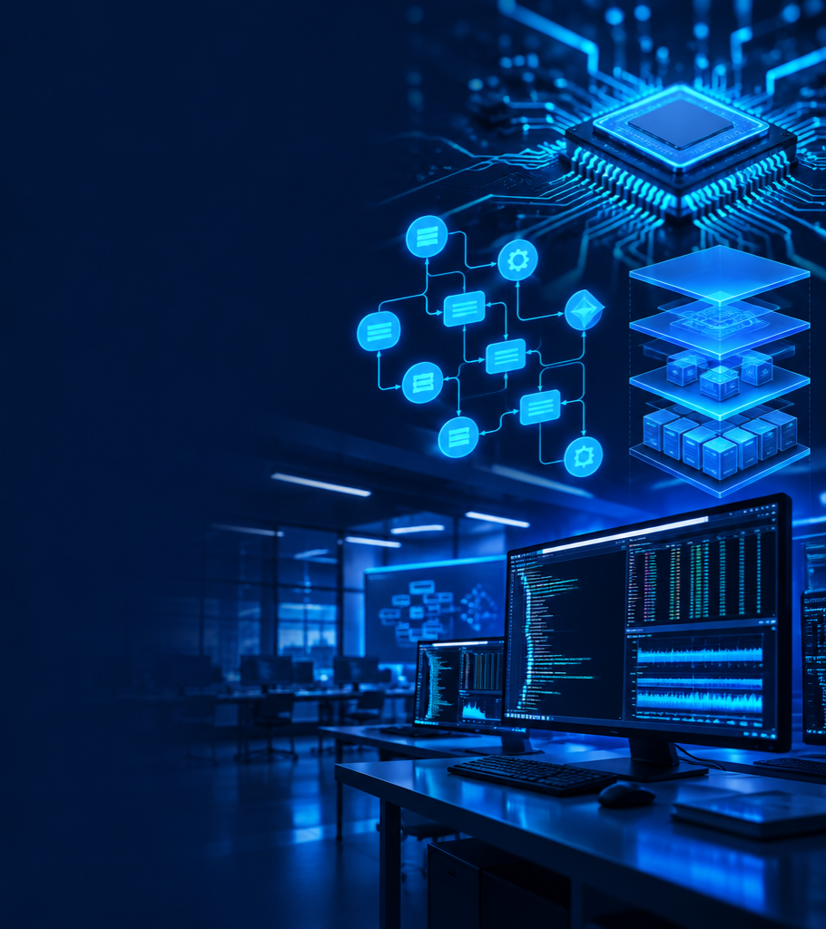
System Programming
Laboratory Toolkit
A unified environment for learning operating systems by building with them.

Slide 2
System programming makes the OS tangible.
Software that works directly with operating-system services, hardware resources, processes, and memory.
$ ./learn_os --hands-on
> trace system calls
> observe process state
> connect theory → behavior
SYSTEM CALLS
PROCESSES
MEMORY
THREADS
UNIFIED
LEARNING
A unified toolkit removes setup friction and lets students focus on how concepts interact.

Slide 3
The lab experience is fragmented.
01
fork(); wait();
open(); read();
pipe(); signal();
Experiments live in separate silos
02
The same setup code is rewritten
03
Modules rarely demonstrate interaction
CONFUSION BETWEEN
CONCEPTS & IMPLEMENTATION
04
System-level behavior stays abstract

Slide 4
One interface. Six connected capabilities.
Execute, observe, and compare core operating-system behavior in one learning environment.
FILE
OPERATIONS
SCHEDULING
CONCEPTS
SYSTEM PROGRAMMING
TOOLKIT
PROCESS
MANAGEMENT
IPC
THREADING
SIGNALS

Slide 5
A clear path from intent to kernel.
USER INTERFACE
Five focused modules share one controller and one system-call layer.
TOOLKIT CONTROLLER
FILE
EXPERIMENT MODULES
PROCESS
IPC
SYSTEM CALLS LAYER
THREAD
SIGNAL
LINUX KERNEL

Slide 6
From source code to observable behavior.
Each experiment exposes the call, its result, and its effect on the running system.
FILE HANDLING
open · read · write · close
PROCESS CREATION
fork
PROGRAM EXECUTION
exec
SYNCHRONIZATION
wait
SIGNAL HANDLING
PIPE COMMUNICATION
RUN → TRACE → EXPLAIN → REPEAT

Slide 7
Processes branch. Threads multiply execution.
PARENT PROCESS
CHILD PROCESS A
CHILD PROCESS B
CHILD PROCESS C
THREAD 1
THREAD 2
THREAD 3
THREAD 4
fork() exec() wait() pthread_create() pthread_join()

Slide 8
Processes coordinate through channels and signals.
PROCESS A
producer
PROCESS B
consumer
PIPE / SHARED CHANNEL
SIGNAL / TERMINATION
pipe() · dup2() · signal() · kill()

Slide 9
Less repetition. More understanding.
INTEGRATED
FASTER
experiment execution
LAB ENVIRONMENT
CLEARER
OS concept mapping
BUILD
OBSERVE
UNDERSTAND
REUSABLE
module foundation
DEBUGGABLE
system-call exposure

Slide 10
The toolkit can evolve with the curriculum.
GUI-BASED
INTERFACE
SCHEDULING
SIMULATOR
REAL-TIME
MONITORING
NETWORK
PROGRAMMING
MEMORY
VISUALIZATION
ONE EXTENSIBLE SYSTEMS LEARNING PLATFORM

Slide 11
Thank you.
A unified platform for practical system programming—connecting core OS concepts with real implementation.
CPU
SYSTEM
READY
“Learning Operating Systems is most effective when concepts are explored through real system-level implementation.”
$ toolkit --continue-learning

